Slide 1
Causality, through the Backdoor
Pavankumar Gurazada

Slide 2
Agenda
Why do we need causality? (No, joint distributions were not enough)
Do-calculus formalizes causality (No, graduate-level mathematics was not enough)
The dowhy package enables estimation of causality
An example from economics: Does the presence of robust private institutions cause economic prosperity?
Causality in the wild

Slide 3

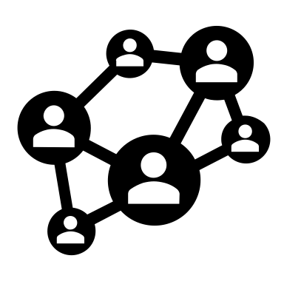


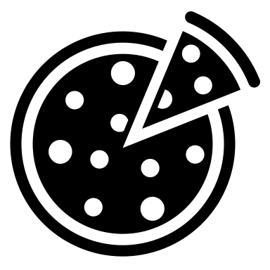

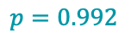
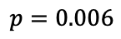
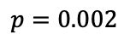
Introducing BlockbusterNet
$$p=0.992$$
Ground truth
$$p=0.002$$
Blockbuster algorithm
Social signals
$$p=0.006$$
But
=

Slide 4

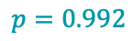
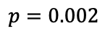
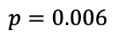
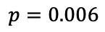
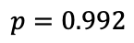
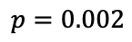
Since BlockbusterNet is so accurate… is this likely?
$$p=0.992$$
$$p=0.002$$
$$p=0.002$$
$$p=0.992$$
Blockbuster algorithm
Social signals
Tampered social signals
$$p=0.006$$
$$p=0.006$$
Model
Intervene
Measure
God Complex

Slide 5
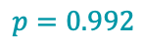
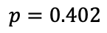
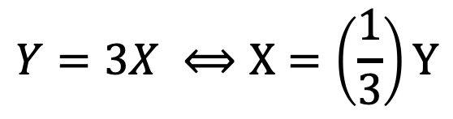
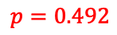
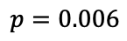
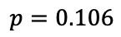
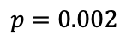
Or is this likely?
$$p=0.992$$
$$p=0.402$$
$$p=0.002$$
$$p=0.106$$
Blockbuster algorithm
Social signals
Tampered social signals
$$p=0.006$$
$$p=0.492$$
Model
Intervene
Measure
$$Y=3X ⟺X=\left(\frac{1}{3}\right)Y$$
(Not-so God Complex)

Slide 6
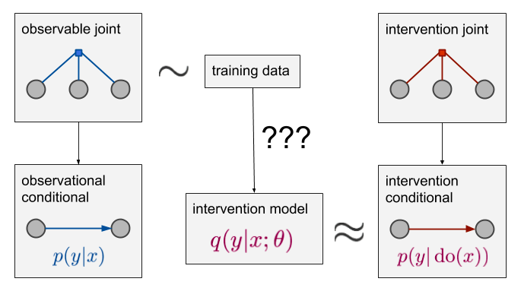
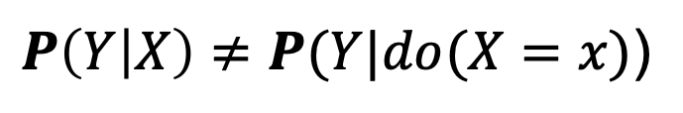
The ruin of joint distributions
$P\left(Y | X\right)≠P(Y|do(X=x)$)
Ference, 2018 (https://www.inference.vc)

Slide 7
The ladder of causality
Observational inference is okay if it does not drive decision making
If decision making is an offshoot of the model, pause, and think of a causal approach
Pearl, 2018 (The Book of Why)

Slide 8
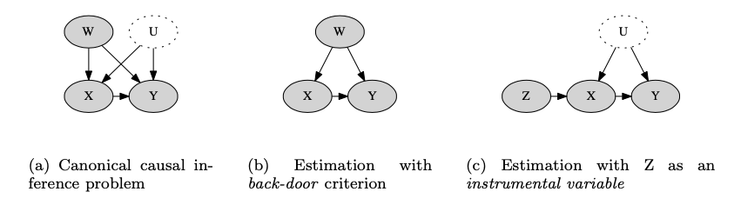
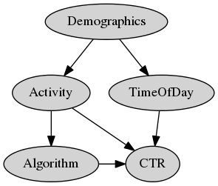
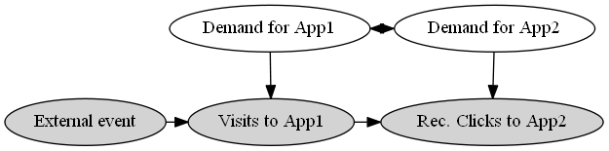
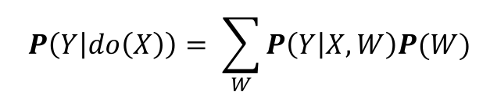
Do-calculus enables a backdoor to causality
Step 1
Step 2
$$P\left(Y | do\left(X\right)\right)= \sum_{W}{P\left(Y | X, W\right)P(W)}$$
(Pearl, 2009)
Look for (undirected) paths that point to both treatment ($X$) and outcome ($Y$). These are the backdoors
Cover all backdoors
Example 1
(Sharma, 2018)
Example 2

Slide 9
Do-calculus enables a backdoor to causality
All bets are off if there are unobserved common-causes

Slide 10
Dowhy enables estimation of causality
Model
Do-calculus
Refute
Identify
Potential outcomes
Estimate
Sharma et. al (2018)

Slide 11

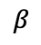
Do stable private institutions cause prosperity? (Acemoglu, 2001)
Step 1
Protection against expropriation
$$β$$
logGDP
Latitude
Asia
Africa
NotAsiaAfrica
Model 1

Slide 12
Do stable private institutions cause prosperity? (Acemoglu, 2001)
Step 1
Protection against expropriation
$$β$$
logMortality0
logGDP
Latitude
Asia
Africa
NotAsiaAfrica
Model 2

Slide 13
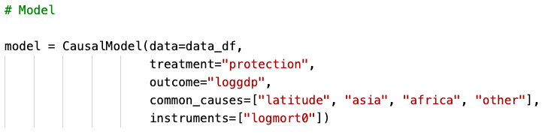
Do stable private institutions cause prosperity? (Acemoglu, 2001)
Step 1

Slide 14
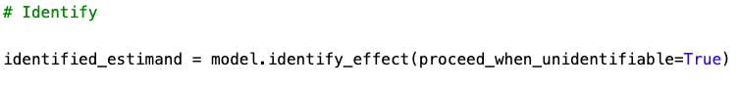
Do stable private institutions cause prosperity? (Acemoglu, 2001)
Step 2

Slide 15
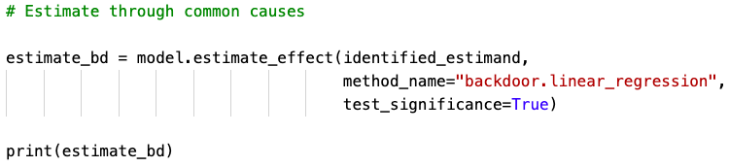
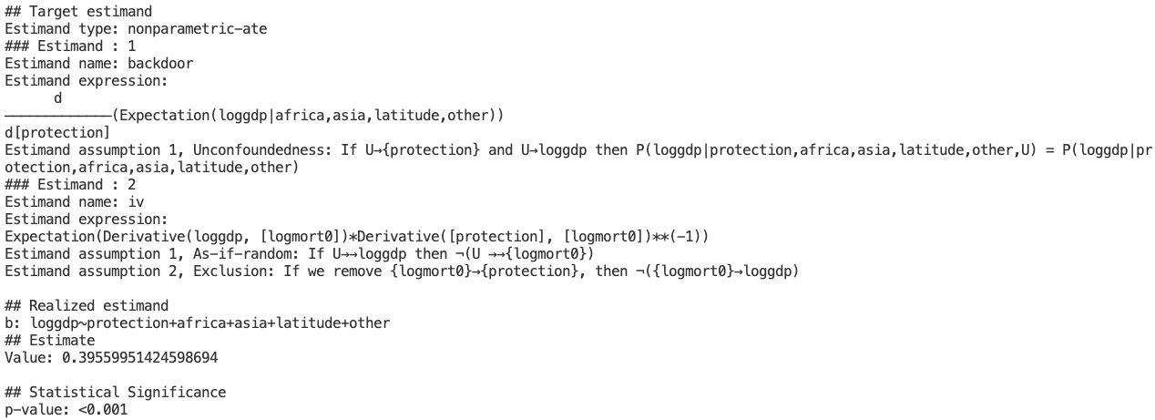
Do stable private institutions cause prosperity? (Acemoglu, 2001)
Step 3 (Model1)

Slide 16
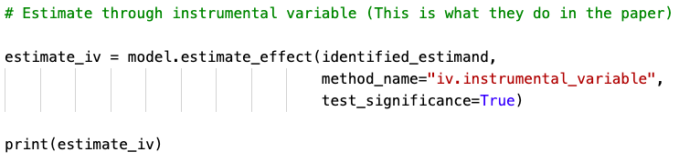
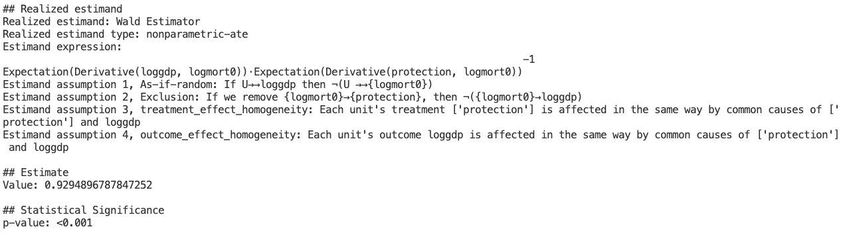
Do stable private institutions cause prosperity? (Acemoglu, 2001)
Step 3 (Model2)

Slide 17
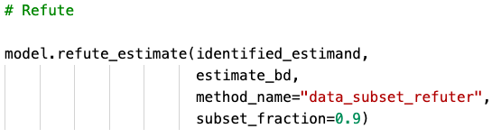
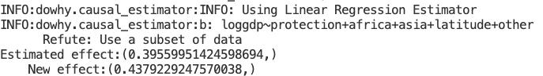
Do stable private institutions cause prosperity? (Acemoglu, 2001)
Step 4 (Model1)

Slide 18
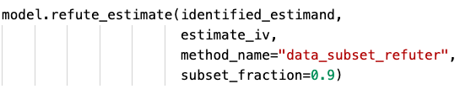
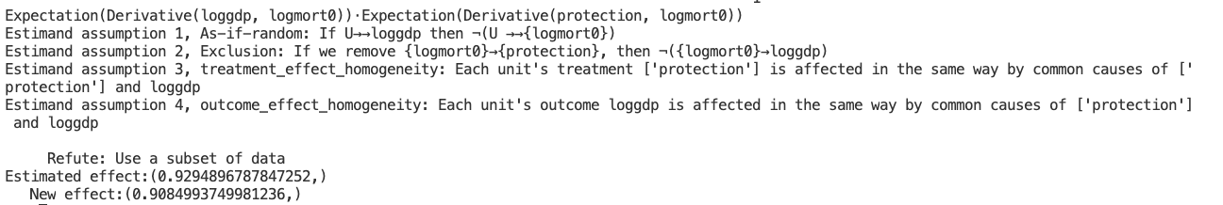
Do stable private institutions cause prosperity? (Acemoglu, 2001)
Step 4: (Model2)

Slide 19
Do stable private institutions cause prosperity? (Acemoglu, 2001)
Yes, increasing robustness of private institutions by 1 unit increases logGDP by 0.93 units
The Backdoor underestimates causal effect by 1/3rd; it is less robust to refutation and we are not sure if all common causes are accounted for
Instrumental variables (if we can find some) save us when there are unobserved common causes. In this example, they are also robust to refutation.

Slide 20
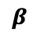
Do stable private institutions cause prosperity? (Acemoglu, 2001)
Protection against expropriation
$$β$$
logGDP
W
Backdoor

Slide 21
Do stable private institutions cause prosperity? (Acemoglu, 2001)
Protection against expropriation
Random assisgnment
$$β$$
logGDP
W
Randomized Control Trial

Slide 22
Do stable private institutions cause prosperity? (Acemoglu, 2001)
Protection against expropriation
logMortality0
$$β$$
logGDP
W
Instrumental Variables

Slide 23

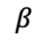
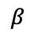
Do stable private institutions cause prosperity? (Acemoglu, 2001)
Protection against expropriation
Random assisgnment
$$β$$
logGDP
Randomized Control Trial
W
Protection against expropriation
logMortality0
$$β$$
logGDP
Instrumental Variables
W

Slide 24
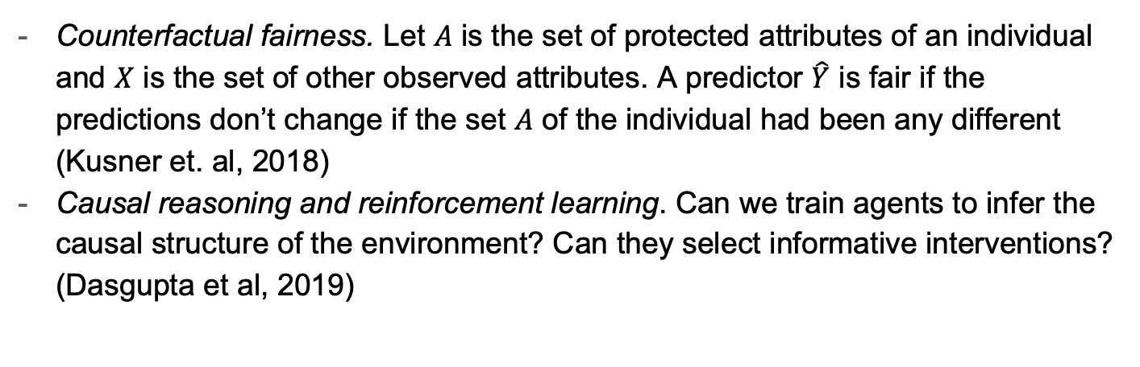
Causality in the wild
Counterfactual fairness. Let $A$ is the set of protected attributes of an individual and $X$ is the set of other observed attributes. A predictor $\hat{Y}$ is fair if the predictions don’t change if the set $A$ of the individual had been any different (Kusner et. al, 2018)
Causal reasoning and reinforcement learning. Can we train agents to infer the causal structure of the environment? Can they select informative interventions? (Dasgupta et al, 2019)

Slide 25
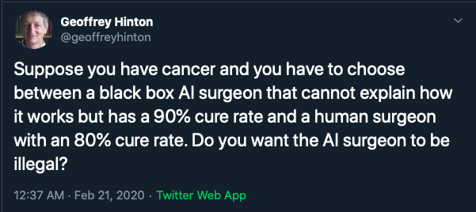
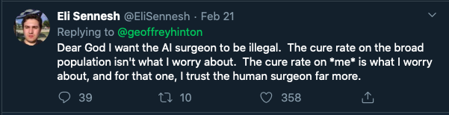
Thank you

